Slide 1
Plotinus Dr. Stephanie Spoto sspoto@mpc.edu Monterey Peninsula College
Gentrain
31 January 2019

Slide 2
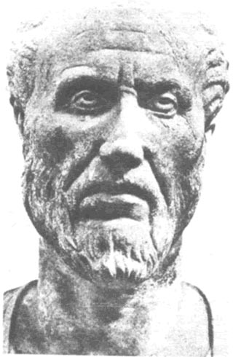
Plato's Philosophy With Religious Spin
Neoplatonism → system of mystical philosophy and theology
Founded by Plotinus (204-270 CE).
Influenced by Stoicism, Pythagoreanism, and—of course—Plato.
It was developed by a number of his contemporaries or near contemporaries, including Iamblichus, Porphyry, and Proclus.
Why “Neoplatonists”?
Hellenistic period, when Plotinus was alive, readers of Plato would have been known simply as Platonists.
19th century→ German scholars created a new word, “Neoplatonism”→ separate out the thought of Plotinus from Plato.
Neoplatonists differed from Platonists: incorporated mystical/religious practices.
“Academic Platonists”: traditional, non-religious method

Slide 3
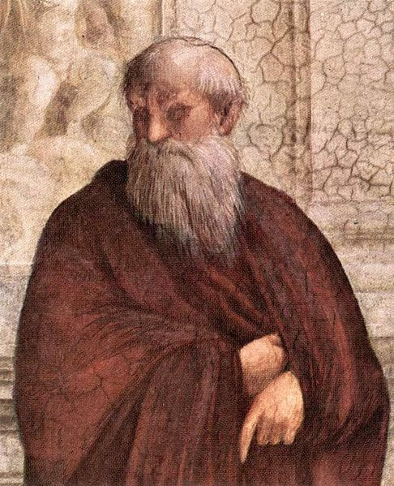
Plotinian Neoplatonism
Synthesis of Christian and Gnostic ideas with traditional Platonic philosophy.
Major question: How do we account for a flawed world when the mind of the creator is perfect?
All existence is mere external expression of contemplative deity known as “The One” or “The Good.”
Expression of God is similar to the expression of individual soul: Expression moves from Form (perfect conception) to the flawed expression of materially derived ‘personality’→ becomes less than divine
The reduction divinity in a temporality is necessary for the complete expression of the One.
Individual soul elevated to the status of an actualization of a divine Form→ preserved autonomy and necessity of ‘personality’

Slide 4
Plotinian Neoplatonism Personality
When the soul moves itself deeper into the chaos of materiality, it loses the memory of its divine origin→ identifies itself more and more with its surroundings.
Identifies with the act, rather than remembering and identifying as an agent of the act → relinquishes the soul’s divine nature.→ accrues alien encrustations: the personality
In his Ennead, Plotinus claims the soul only needs to "think upon essential being“ to return to itself.
In his Essay on the Beautiful, he writes: “Let us, therefore, re-ascend to the good itself, which every soul desires; and in which it can alone find perfect repose.”

Slide 5
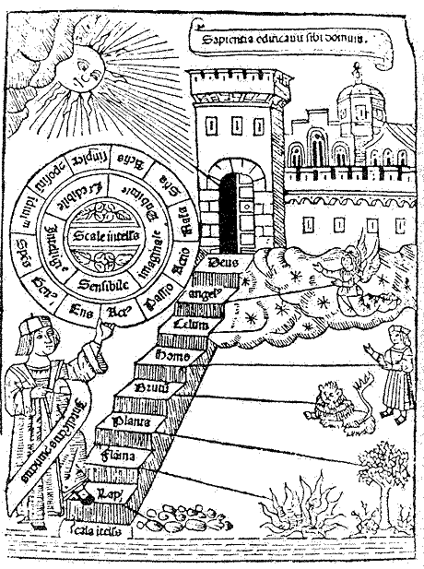
Neoplatonic Spheres
I am made by a God: from that God I came perfect above all forms of life, adequate to my function, self-sufficing, lacking nothing: for I am the container of all, that is, of every plant and every animal, of all the Kinds of created things, and many Gods and nations of Spirit-Beings and lofty souls and men happy in their goodness.

Slide 6
The Plotinean Cosmos
The universe/Cosmos is not a divined created order → therefore, we can not blame this creator for the existence of evil.
Cosmos: self-expression of the Soul→ the great Intelligence (nous)
The product or result of the Soul’s experience of own Mind (nous).
In a perfect world, this concrete expression of the Soul should help it by serving as a reference for its own existence as self-conscious→ this is not the case. Instead the Soul easily falls into the trap of valuing the expression over the Principle (the contemplation of divine Forms).
This error creates evil→ the divided soul and relation to the manifold forms of the expressive act.
The creation of nature: The Soul becomes concerned and preoccupied with its own experience, this gives rise to Nature.

Slide 7
The soul in error
Since the soul is in error when it is thoroughly identified with the body, and shares its experiences and has all the same opinions, it will be good and possess virtue when it no longer has the same opinions but acts alone–this is intelligence and wisdom–and does not share the body’s experiences–this is temperance–and is not afraid of departing from the body–this is courage–and is ruled by reason and Nous, without opposition–this is justice. One would not be wrong in calling this state of the soul likeness to God, in which its activity is intellectual, and it is free in this way from bodily affections.
(Enneads)

Slide 8
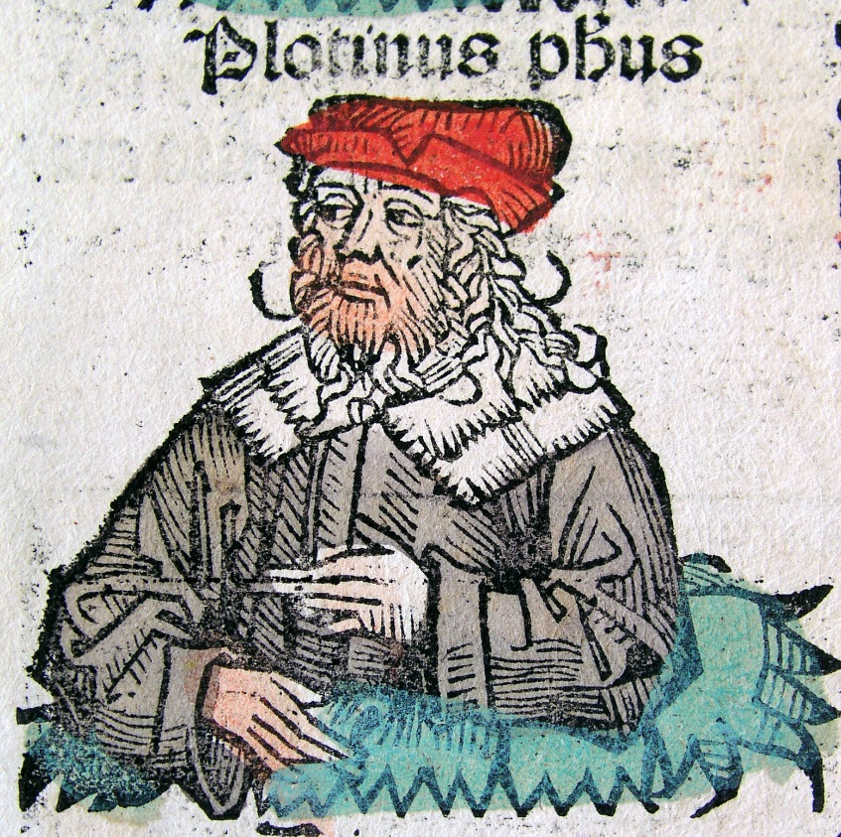
Contemplation and Creation
Perhaps influenced by Plato’s Academy→ The One is transcendent and “beyond being”
Plotinus claims that the One is ineffable and “alone with itself”
Creation: The One does not create the universe, but merely generates it from itself→ a power that is both Intellect (nous) and the Intellect’s object of contemplation.
The One: thinks itself as itself
The Intellect: thinks itself as other → creates division within itself → the production of Being
It is through contemplation that there is expression and creation: from the Forms arise the Soul, whose task it is to think these Forms and produce a concrete and living expression of the divine Intellect (nous) → results in the creation of many individual souls → living expressions of potentiality

Slide 9
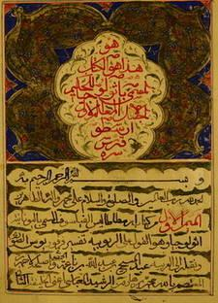
The Soul Forgets Itself
Intellect divided within itself → Soul divided outside of self through action (lowest form of contemplation) → this division creates the world (the expressive act of the Soul, i.e. Nature)
When the individual soul recognizes Nature as emanating from the self, the soul can attain insight into the Intellect
But, if the soul false believes Nature to be external and objective, then evil and suffering comes into the world.
Arabic adaptation of the influential treatise On the Immortality of the Soul by the Greek Neoplatonism philosopher Plotinus

Slide 10
Salvation and the Cosmic Process
Similar to his contemporary, the Christian philosopher Origen of Alexandria, Plotinus views the soul’s move down into the material world as a necessary part of the existence of the divine Intellect (God).
Since it is necessary, the descent is not in itself evil→ mere reflection of Intellect’s essence.
Origen & Plotinus: evil is the fault of the individual soul → rational soul will naturally choose the Good → failure is the result of forgetfulness/ignorance.
Why this failure?
Origen: souls were spiritual beings and when they desired to create something independently from God, they fell into error
Plotinus: Perhaps would have disliked this view, as it seems Gnostic and Plotinus was an opponent of Gnosticism.
"Likeness to God as far as possible," for Plotinus, is really likeness to oneself→ authentic existence.
God is not external to anyone, but is present with all things, though they are ignorant that he is so. (Enneads)

Slide 11
Plotinus’s Last Words
In his biography of Plotinus, Porphyry records the last words of his teacher to his students as follows: "Strive to bring back the god in yourselves to the God in the All" (Porphyry, Life of Plotinus2,).
Passed away after making this statement
Seems at odd→ so simple against such rigorous philosophical treatises.
How should we understand this remark? Mystical and religious?
Always worked for intellectual clarity when wrestling with the question of humankind’s connection to God → desiring salvation was no excuse for giving up oneself to unreflective religious rituals → salvation only achieved through philosophical investigation.

Slide 12
Life and Death are Good
In “On the Primal Good”, his last treatise, he asserts that both life and death are good.
Life, because it is when the soul expresses itself → however, life leads to exhaustion because it is characterized by action. Leads to desire for contemplation → to have this fulfilled is to desire the purely intellectual and the eternal.
Death is good because it is the relief from this action and exhaustion → returning to contemplation
Potentiality vs. Actuality? Is death (the return to the Intellect) a return to pure potentiality?
Edward Moore: “It is hard to say. Perhaps it is a synthesis of potentiality and actuality: the moment at which the soul is both one and many, both human and divine. This would constitute Plotinian salvation -- the fulfillment of the exhortation of the dying sage.”

